Slide 1

OPERATING SYSTEMS PROJECT A NOVEL TASK-DUPLICATION BASED DAG SCHEDULING ALGORITHM FOR HETEROGENEOUS ENVIRONMENTS
Kun He, Member, IEEE, Xiaozhu Meng, Zhizhou Pan, Ling Yuan, Pan Zhou Member, IEEE
BY:
JAI GARG (DTU/2K18/MC/044)
JATIN PAPREJA (DTU/2K18/MC/049)

Slide 2

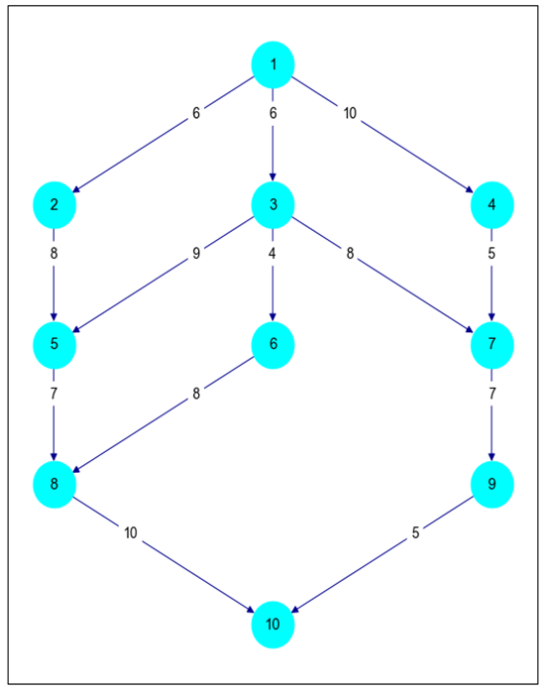
Introduction:
Heterogeneous systems consists of multiple cores having different architecture resulting in different computational power for each core. As a crucial task in heterogeneous distributed systems, DAG-scheduling models a scheduling application with a set of distributed tasks by a Direct Acyclic Graph (DAG).
In this project, we have implemented a novel algorithm, called the Task Duplication based Clustering Algorithm (TDCA), to effectively perform task duplication and improve the scheduling quality. TDCA improves the schedule performance by utilizing duplication task more thoroughly. It improves parameter calculation, task duplication, and task merging. TDCA aims to improve upon the schedule makespan for heterogeneous systems for various communication-computing cost ratios.
Fig. 1. A DAG Example

Slide 3
Literature Survey:
There are three main types of the DAG scheduling algorithms: List Scheduling, Cluster-Based Scheduling, and Task Duplication-Based Scheduling. Hybrid algorithms have also been developed that combines algorithms given above. Various Scheduling Algorithms have been developed such as:
Heterogeneous Earliest Finish Time (HEFT)
Dynamic Critical Path Duplication (DCPD)
Task duplication-based scheduling Algorithm for Network of Heterogeneous systems (TANH)
The proposed algorithm TDCA is based on the framework introduced in TANH scheduling. TANH algorithm allows other algorithms to take a huge leap. But, it has some limitations as well such as:
Definitions of several parameters are rather loose.
In the initial cluster generation step, it always keeps adding nodes to a cluster until the entry-node is added.
In the task duplication step, it does not show the exact order of the positions of performing task duplication.
One key difference between TDCA and TANH is that TDCA uses both task duplication and cluster merging to reduce the makespan, while TANH only applies one depending upon the initial clustering.

Slide 4
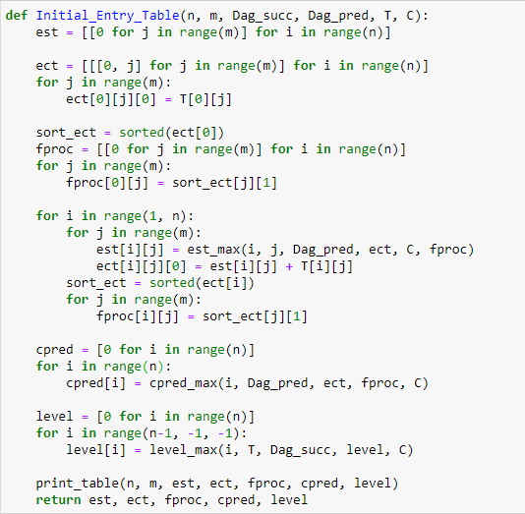
Approach:
The Task Duplication-Based Clustering Algorithm (TDCA) has been broadly categorized into five phases:
Definitions of Key Parameters
Phase I - Initial Task Clustering
Phase II - Task Duplication
Phase III - Task Merging
Phase IV - Task Insertion
Key Parameters:
Earliest Starting Time (est)
Earliest Completion Time (ect)
Favorite Processor (fproc)
Critical Predecessor (cpred)
B-level Task Priority (level)
Fig. 2. Code Cell for calculating Key Parameters

Slide 5
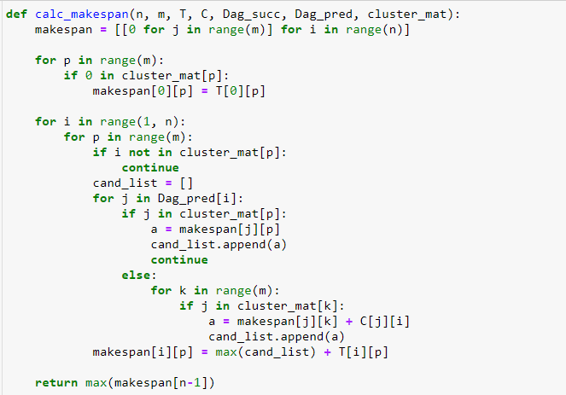
Four Phases Of TDCA:
Initial Task Clustering Phase:
After the calculation of the key parameters, tasks are sorted by their levels in non-decreasing order. TDCA starts to construct the initial clusters.
Task Duplication Phase:
A task duplication method is used to modify the initial clusters in order to shorten the makespan.
Task Merging Phase:
In this phase, we try to merge clusters to see if the makespan could be further reduced.
Task Insertion Phase:
In this phase, for each predecessor-successor pair, the predecessor is inserted in the cluster containing the successor, if this improves scheduling performance.
Fig. 3. Function for calculating Schedule Makespan

Slide 6
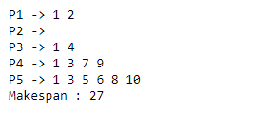
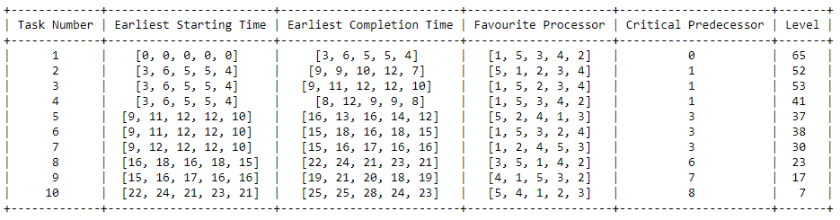
Results:
In order to analyze the results and performance, TDCA is compared to the well known scheduling algorithms namely: DCPD, HEFT, TANH. The Time Complexity of the TDCA comes out to be O(mne + m²e) whereas the Space Complexity comes out to be O(mn). The algorithms are evaluated on various parameters in which CCR has the greatest impact on the performance of the algorithms.
Fig. 4. Final Schedule
Fig. 5. Key Parameters

Slide 7
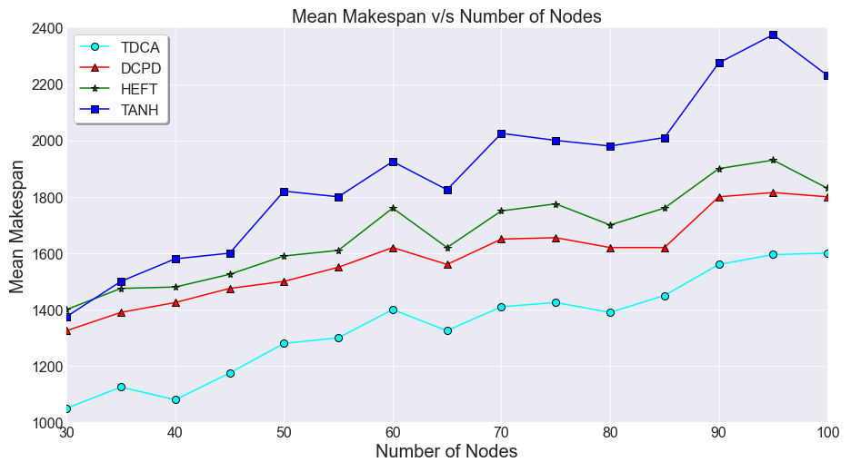
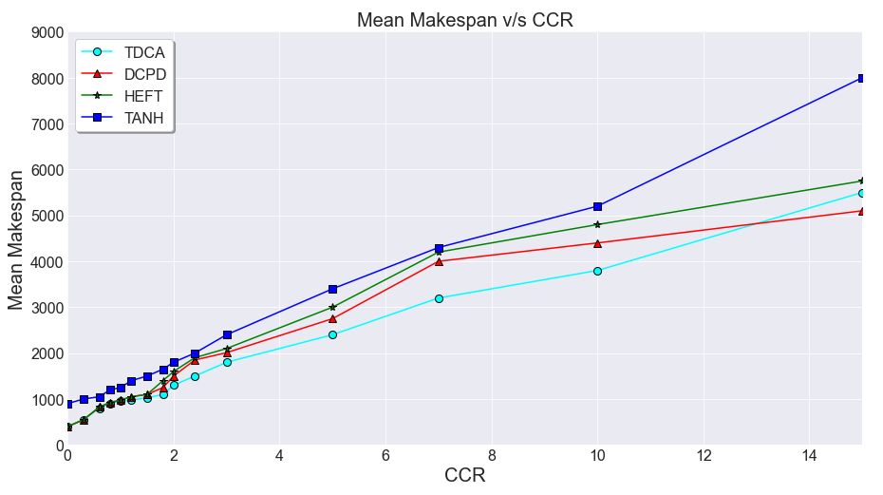
Comparative Results:
First, the performance of TDCA is compared against the existing scheduling algorithms by varying the value of number of nodes (tasks) in the DAG. The number of nodes are varied from 30 to 100. All algorithms scale linearly with the number of nodes. TDCA produces the smallest mean makespan.
Secondly, the impact of Communication-Computation Ratio (CCR) is studied on all four algorithms. When CCR is small, the communication cost between tasks can be negligible and vice-versa. TDCA outperforms other three in range 0.3 to 13. In general, TDCA is the best performing algorithm.

Slide 8
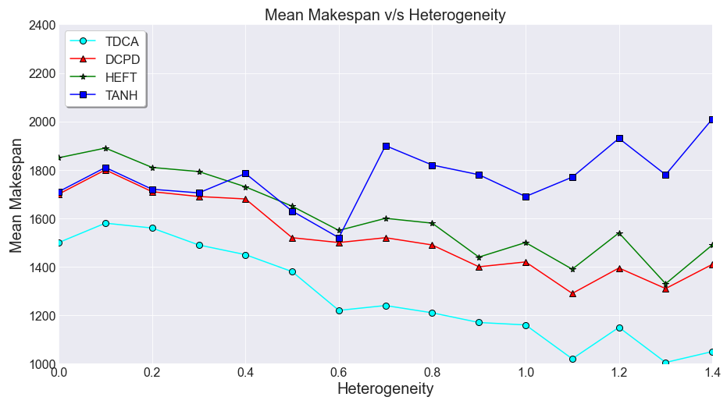
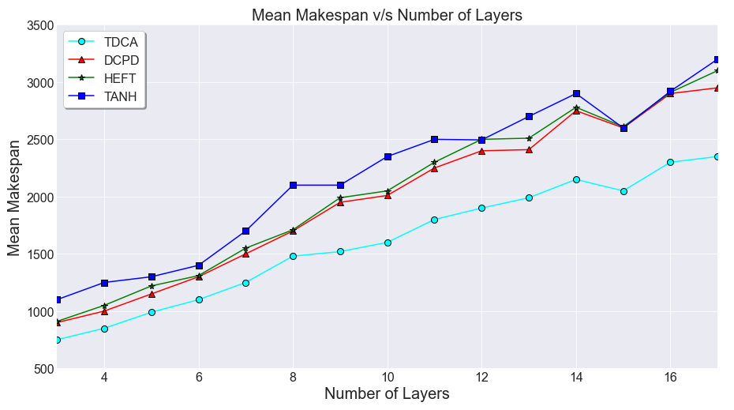
Cont’d:
Next, the impact of heterogeneity parameter (h) is studied on all four algorithms. The larger the value of h is, the more heterogeneous the system is. The results show the mean makespan of different algorithms on different values of parameter h. In all ranges, TDCA produces shortest mean makespan.
Lastly, the impact of number of layers (L) in the DAG is studied. Makespan increases linearly with the number of layers, which is according to the expectations since the large number of layers indicate low parallelism. TDCA performs better than any other algorithm.

Slide 9
Conclusion:
In this project, we have implemented TDCA for the DAG task scheduling problem in the heterogeneous distributed environment. The proposed algorithm utilizes the duplication task more thoroughly involving parameter calculation, task duplication, and task merging. Several key parameters such as Earliest Completion Time (EST) and Critical Predecessor are redefined.
TDCA aims at improving the initial clustering. Existing algorithms typically duplicate the predecessors of a task when producing initial task clusters . On the other hand, TDCA will also consider waiting for transferring the results of a predecessor task from other clusters, which may improve the quality of the initial clusters.
The Duplication and Merging phases are considered to reduce the makespan. During the duplication phase, the order of finding the candidate duplication positions is determined. By analyzing the effect of task duplication, it is concluded that chain reactions exists. After one round of scanning, all duplication candidates are classified into effective and ineffective candidates. In the next round, these ineffective candidates can become effective.
TDCA explicitly outperforms the baseline algorithms without increasing the computation complexity.

Slide 10
Learnings:
In this project, we learned many things. We can break down our learnings into two broad categories:
Technical Learnings: Firstly, we gained a large amount of knowledge regarding Heterogeneous Systems. In our course, we are mainly concerned with the Homogeneous Systems for the convenience. We learned the intricacies and complexities of Heterogeneous Systems in which every processor has its own architecture and computation power. We also understood the basis of Classification of Scheduling Algorithms. Next, we studied about the Types of Priority Levels such as T-Level, S-Level and B-Level. Also, during the study of Priority Levels, we were required to study about the Critical Path Method (CPM) as well. Writing the function for Schedule Makespan pushed us to derive our own method of calculating the makespan as it was not mentioned anywhere else. This project also taught us the working of proposed TDCA Scheduling Algorithm thoroughly. We also learned the impact of various key parameters in terms of performance improvement.
General Learnings: Firstly, we learned how to properly read research papers and how to correlate various research papers written in very different timeframes. It also taught us how to break down very large and complex algorithms into smaller as well as simpler algorithms that can be understood and implemented by people from different countries and domains. We learned how to write modular codes in which debugging can be done easily and its application can be presented in a more sophisticated manner. Above all, we learned a lot about team work, time management and got a gist of how it feels to work on a project that is distributed over months.

Slide 11
THANK YOU

